Slide 1
Java Programming Language
Lesson 1

Slide 2
Introduction
Java programming language was originally developed at Sun Microsystems and released in 1995
"write once, run anywhere"

Slide 3
Java Virtual Machine
The Java virtual machine (JVM) is the component of Java framework that executes the compiled Java code.
When a developer compiles a Java file successfully, the Java compiler produces a bytecode file and has a .class extension.

Slide 4
JDK and JRE
Java development kit and Java Runtime environment
These tools allow a programmer to write Java code and
convert it to a bytecode file to be executed by a JVM

Slide 5
Hello World
Create folder in C:\aca
Open notepad and write this code: and save file in .java extension file name - Hello.java
public class Hello
{
public static void main(String[] args)
{
System.out.println("Hello, World!");
}
}

Slide 6
Hello World
Open cmd and locate your folder using “cd” (cd C:\aca)
Type - set path=%path%;C:\Program Files\Java\jdk1.8.0_25\bin (your path to java)
Run javac Hello.java
Run java Hello
Result Hello, World!

Slide 7
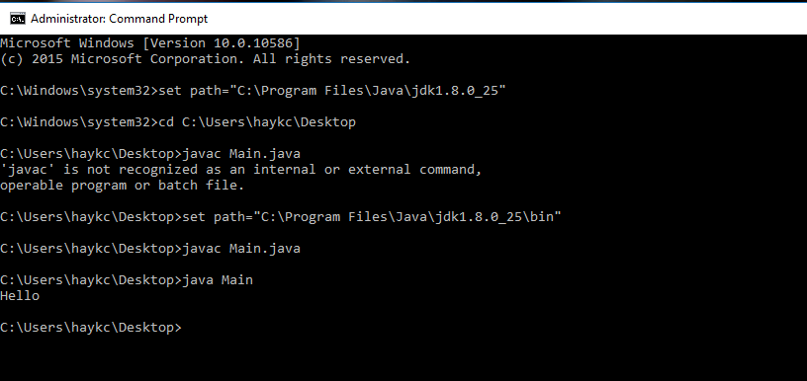

Slide 8
Eclipse IDE
1. Create and Eclipse project which will contain Java file. Click on File, New Java Project.
2. Enter project name then click Finish.
3. On the left pane, under Package Explorer, expand the project then right click on src.
4. Move cursor to New, then click on Class
5. In Name field, enter the class name: Lesson1.java then click finish
6. In the file editor, the file Lesson1.java will open. Type in the same code as the previous
section.
7. Click on the Run button.
8. The “Hello World!” should display in the Console view.

Slide 9
Java Primitive Data Type
Java supports eight different primitive data types:
1. byte: The byte data type is an 8-bit signed integer.
2. short: The short data type is a 16-bit signed integer.
3. int: The int data type is a 32-bit signed integer. It has a maximum value of 2,147,483,647.
4. long: The long data type is a 64-bit signed integer.
5. float: The float data type is a single-precision 32-bit floating point.
6. double: The double data type is a double-precision 64-bit floating point.
7. boolean: The boolean data type has only two possible values: true and false.
8. char: The char data type is a single 16-bit Unicode character.

Slide 10
Byte
Byte data type is an 8-bit signed integer.
Minimum value is -128 (-2^7)
Maximum value is 127 (inclusive)(2^7 -1)
Default value is 0
Byte data type is used to save space in large arrays, mainly in place of integers, since a byte is four times smaller than an int.
Example: byte a = 100 , byte b = -50

Slide 11
Short
Short data type is a 16-bit signed integer.
Minimum value is -32,768 (-2^15)
Maximum value is 32,767 (inclusive) (2^15 -1)
Short data type can also be used to save memory as byte data type. A short is 2 times smaller than an int
Default value is 0.
Example: short s = 10000, short r = -20000

Slide 12
Int
Int data type is a 32-bit signed integer.
Minimum value is - 2,147,483,648.(-2^31)
Maximum value is 2,147,483,647(inclusive).(2^31 -1)
Int is generally used as the default data type for integral values unless there is a concern about memory.
The default value is 0.
Example: int a = 100000, int b = -200000

Slide 13
long
Long data type is a 64-bit signed two's complement integer.
Minimum value is -9,223,372,036,854,775,808.(-2^63)
Maximum value is 9,223,372,036,854,775,807 (inclusive). (2^63 -1)
This type is used when a wider range than int is needed.
Default value is 0L.
Example: long a = 100000L, long b = -200000L

Slide 14
float
Float data type is a single-precision 32-bit IEEE 754 floating point.
Float is mainly used to save memory in large arrays of floating point numbers.
Default value is 0.0f.
Float data type is never used for precise values such as currency.
Example: float f1 = 234.5f

Slide 15
double
double data type is a double-precision 64-bit IEEE 754 floating point.
This data type is generally used as the default data type for decimal values, generally the default choice.
Double data type should never be used for precise values such as currency.
Default value is 0.0d.
Example: double d1 = 123.4

Slide 16
boolean
boolean data type represents one bit of information.
There are only two possible values: true and false.
This data type is used for simple flags that track true/false conditions.
Default value is false.
Example: boolean one = true

Slide 17
char
char data type is a single 16-bit Unicode character.
Minimum value is '\u0000' (or 0).
Maximum value is '\uffff' (or 65,535 inclusive).
Char data type is used to store any character.
Example: char letterA ='A'

Slide 18
Exercises
1. Create java project, create primitive types and print their values as shown:
“int :: 1”
“char :: ‘A’ ”
And etc.
2. Create java project which will answer YES if the computer has an internet connection and NO otherwise.

